Slide 1
XFLR5 Methods and Their Application in “Constraints on the Wing Morphology of Pterosaurs”
By: Colin Parker

Slide 2
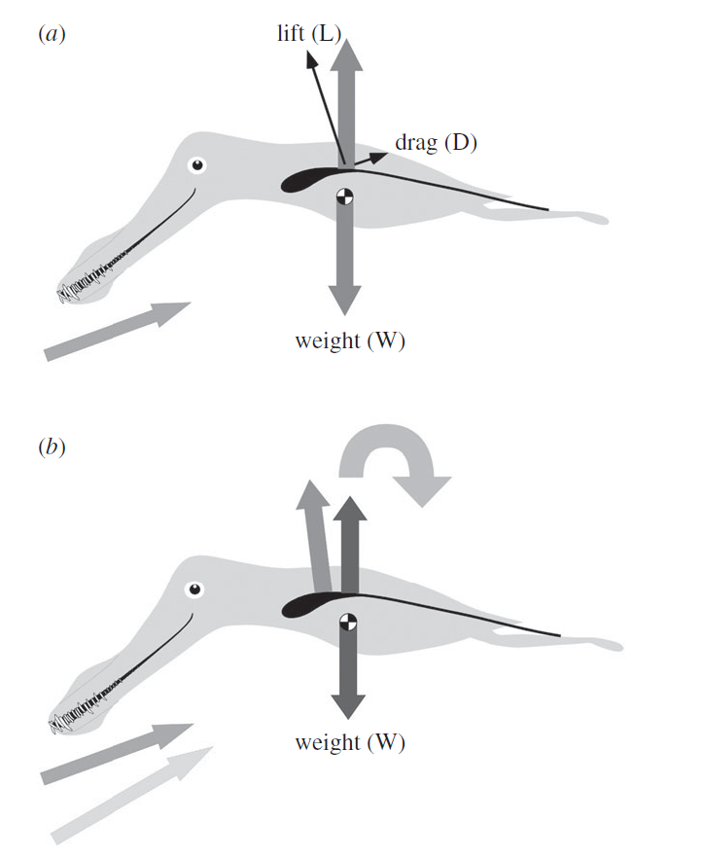
Longitudinal Stability Analysis

Slide 3
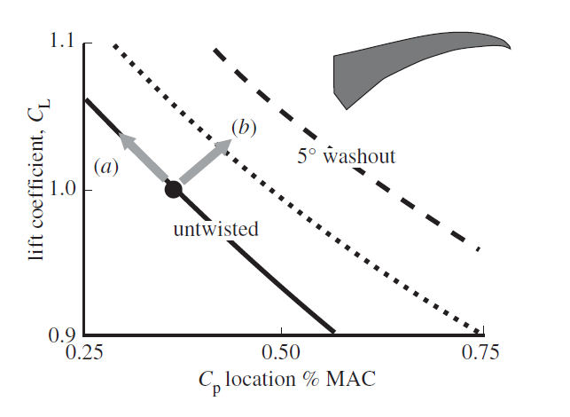
Effects of Washout

Slide 4
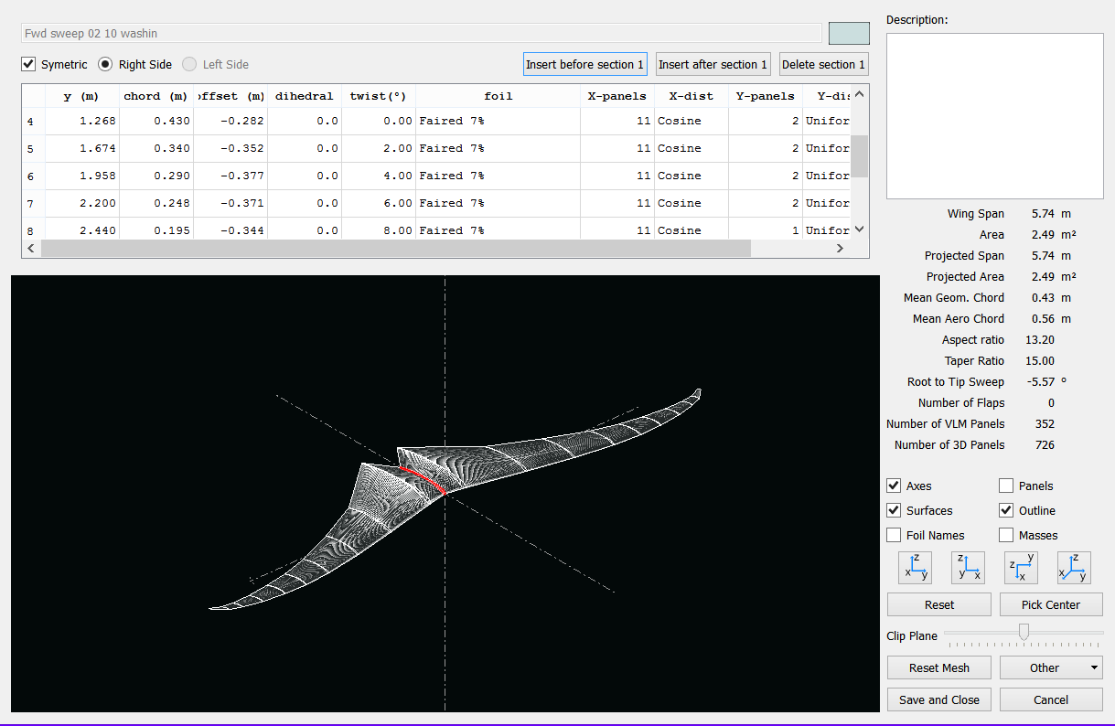
XFLR5

